Slide 1

Final Presentation-Group 10
Aditya Mehta-100856846
Satyajeet Dodiya-100856878
Viraj Prajapati-100864809
Jigneshbhai Vaghela-100921724
Saurabh Singh-100934083

Slide 2
Overview
Final Product
This project is a chatbot implemented in Python using the Flask web framework, Hugging Face's Transformers library for natural language processing (NLP), and MongoDB for data storage.
The chatbot is designed to handle user inquiries about products, provide information, and engage in price negotiation.

Slide 3
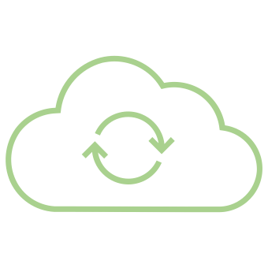
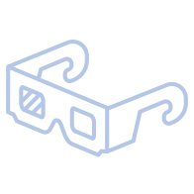
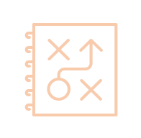
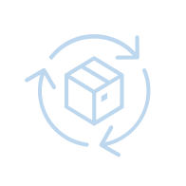
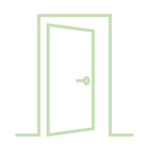

Project timeline
At-a-glance
Warm-Up
Planning
MVP
MMP
Evaluation
Details about the project and course
Detailed project plans created, including development of work breakdown structure.
Functional Prototype of 20% working product
Real working Product at least 75% delivered to PM
Documenting deliverables, conducting reviews, transitioning outcomes.
04
08
06
13
Oct
15
Nov
Dec
Dec
Oct
03

Slide 4
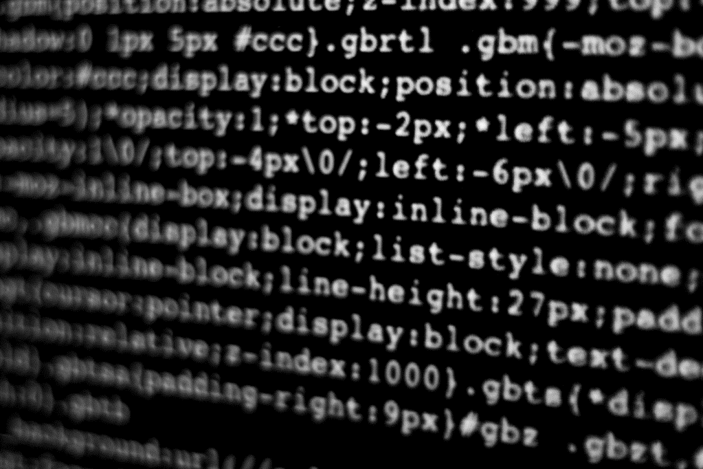
How we did it
Let’s Dive In

Slide 5
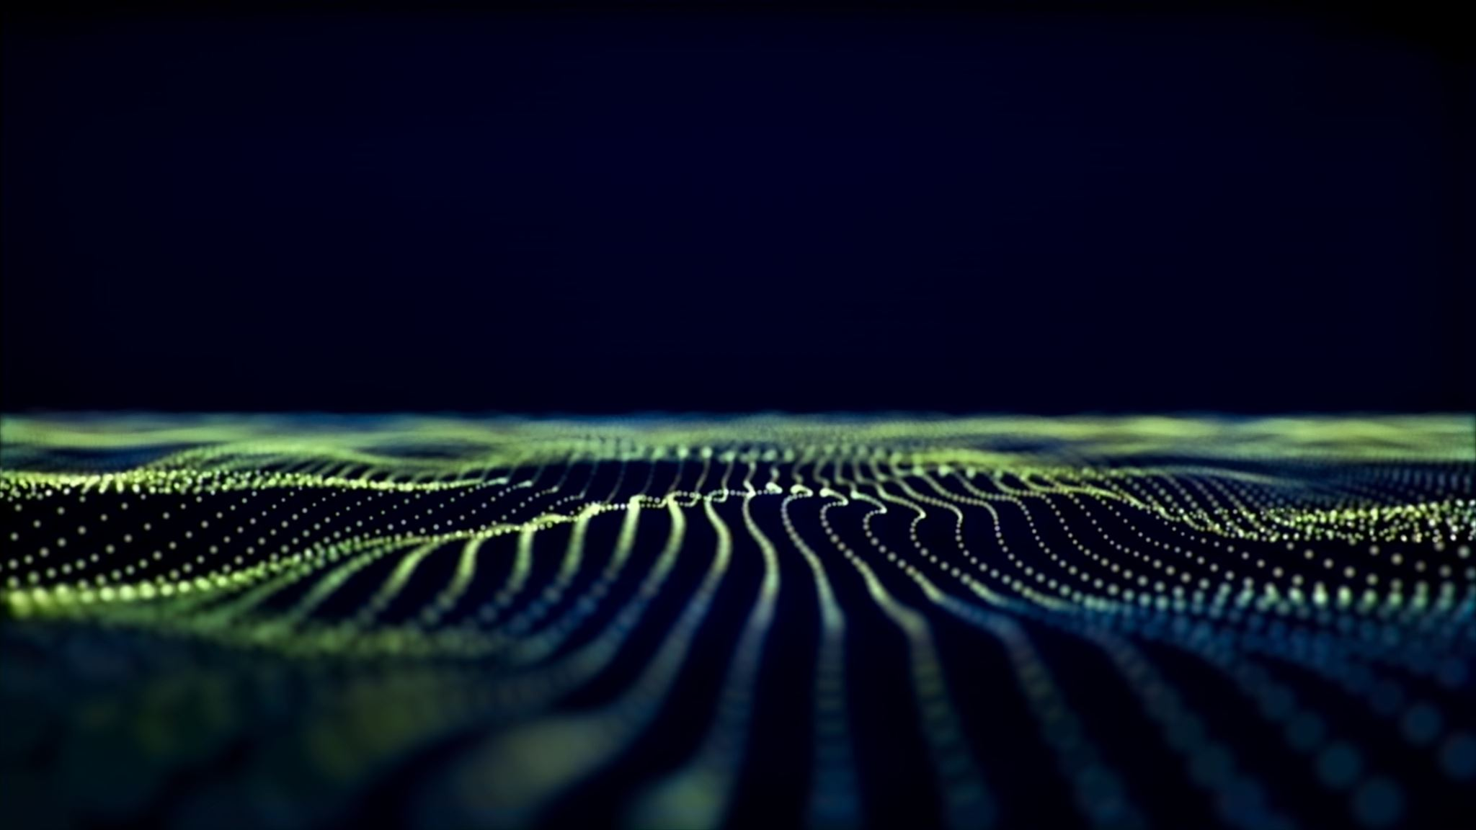
Key Components:
Flask Web Application: The chatbot is hosted as a web application using Flask. Chosen for its simplicity and flexibility as a web framework.
MongoDB Integration: Used to store product information in a database named 'ProductDB.’ Selected for its NoSQL nature, flexibility in handling unstructured data, and ease of scalability
Natural Language Processing (NLP): NLP is used to analyze user input, identify intents (greeting, product inquiry, negotiation), and generate appropriate responses. Ease of use in natural language processing tasks.
Web Interface: The chatbot's responses and negotiation state are sent back to the web interface for display

Slide 6
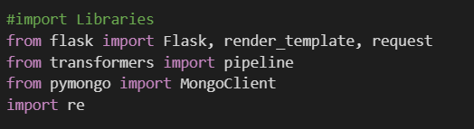
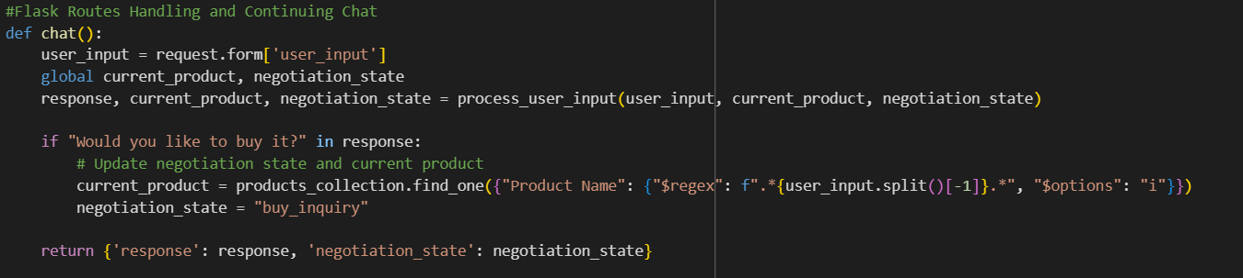
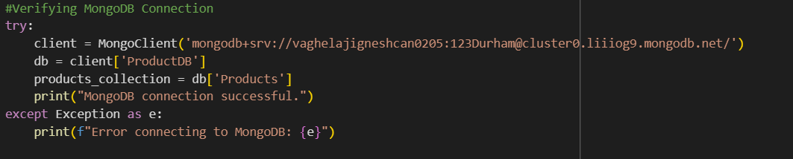
Main Code Elements

Slide 7
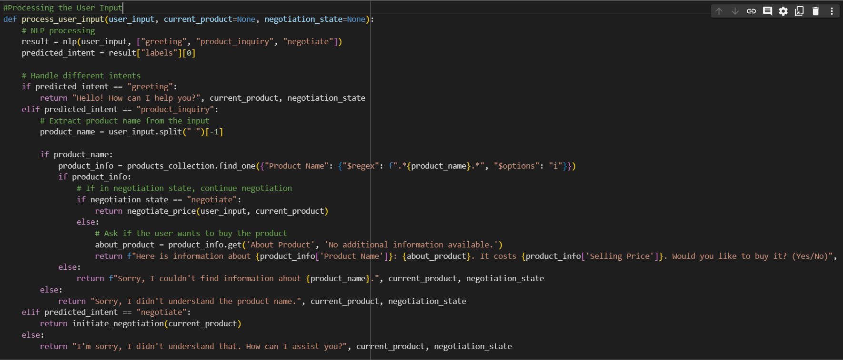
User Input

Slide 8
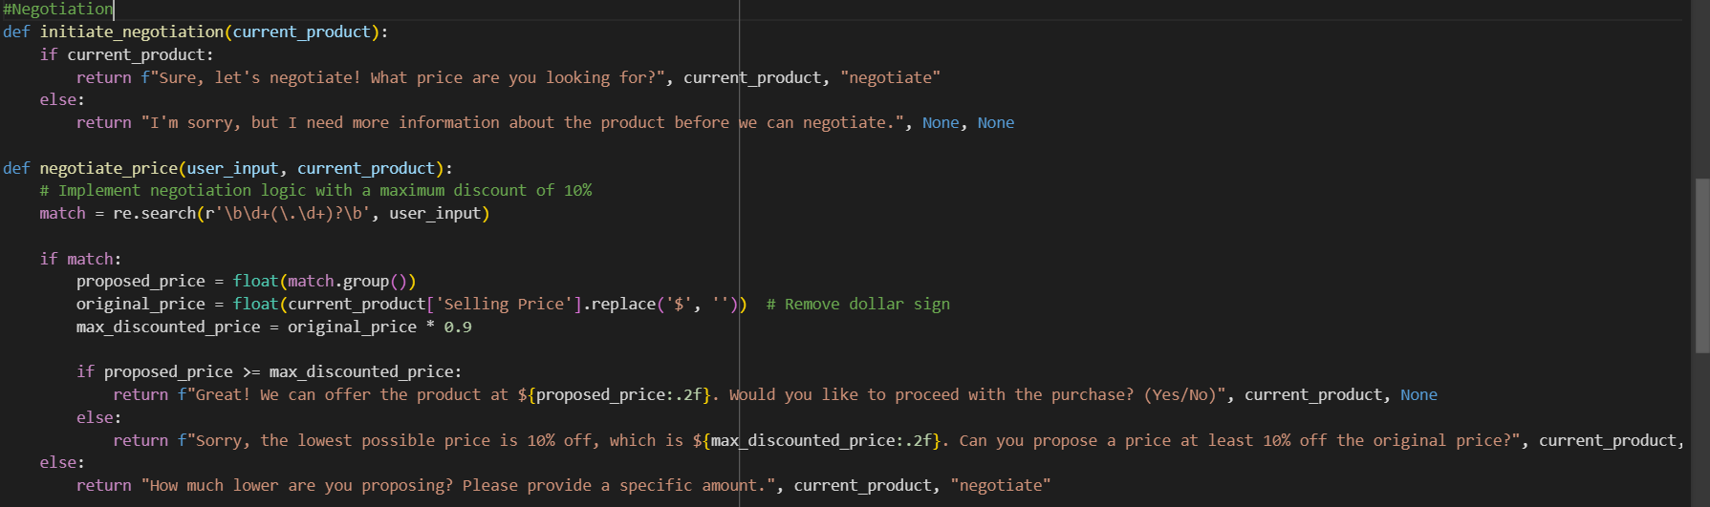
Negotiation

Slide 9
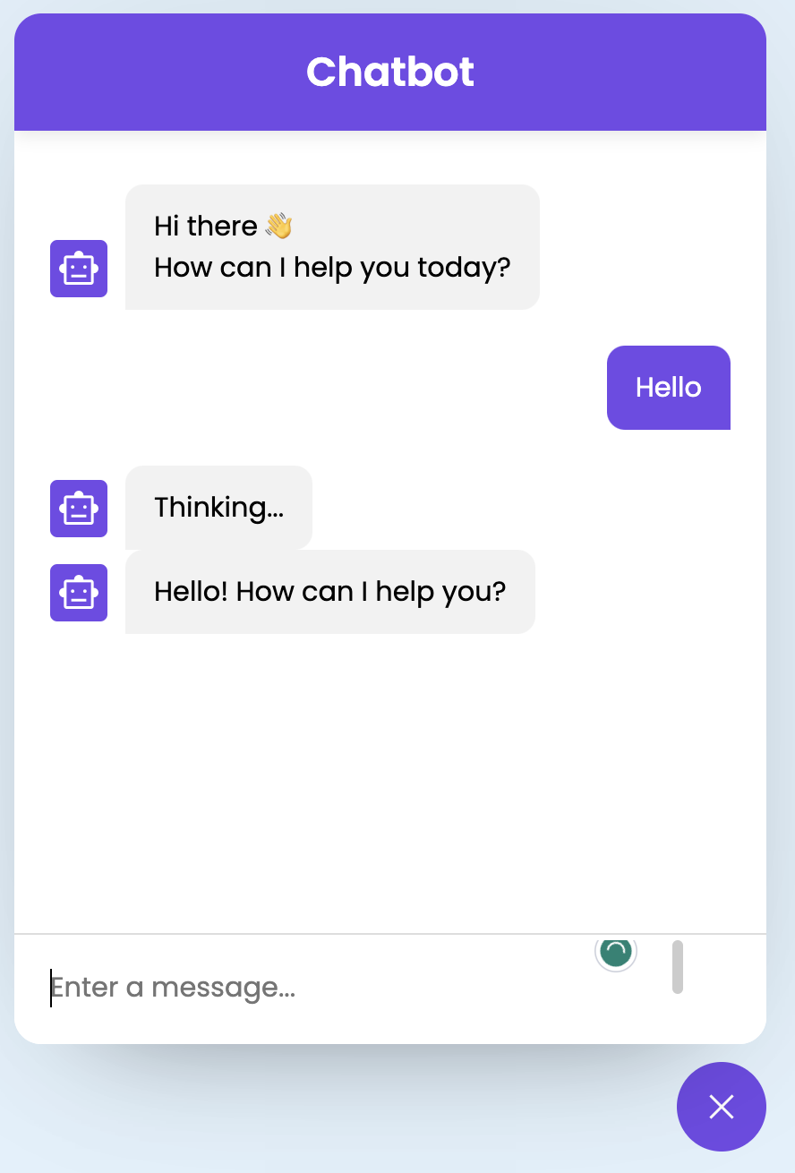
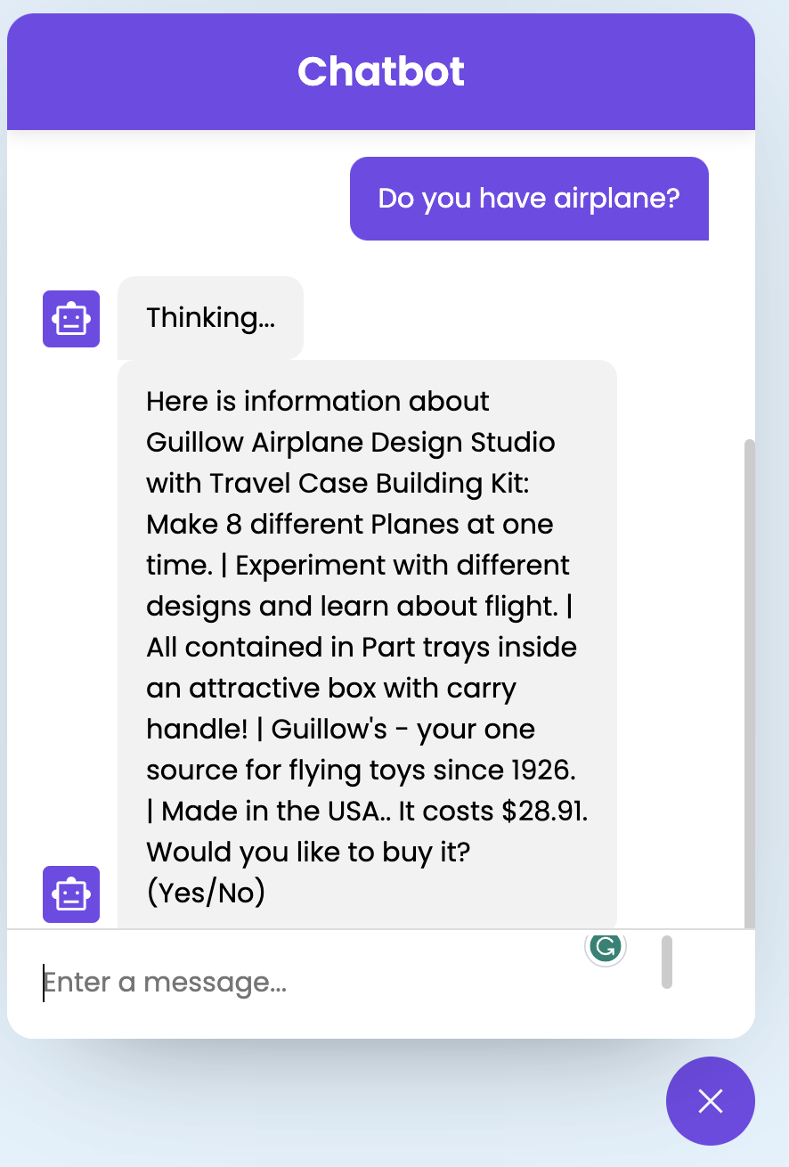
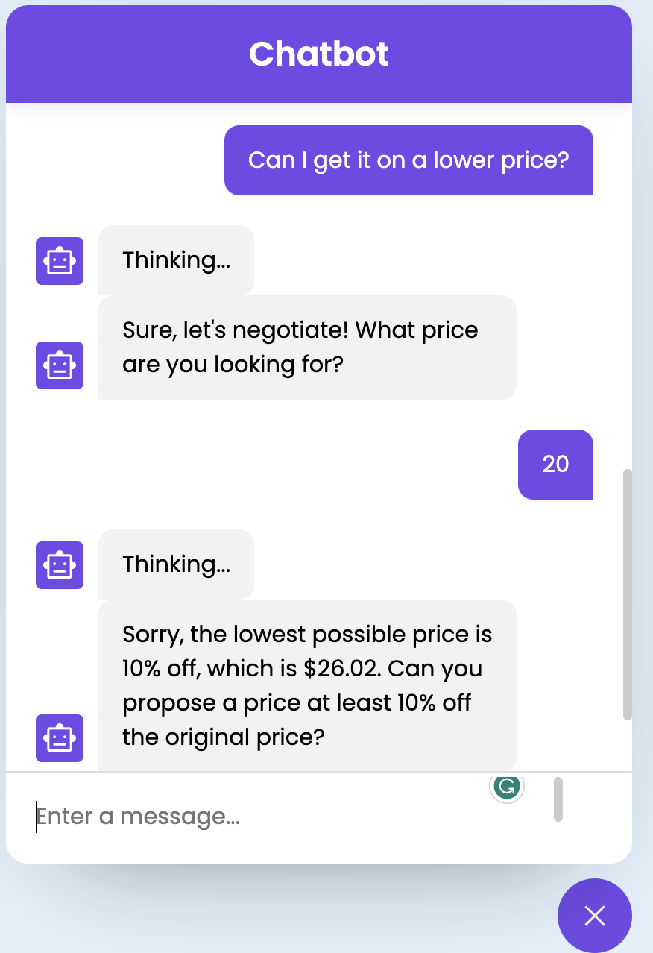
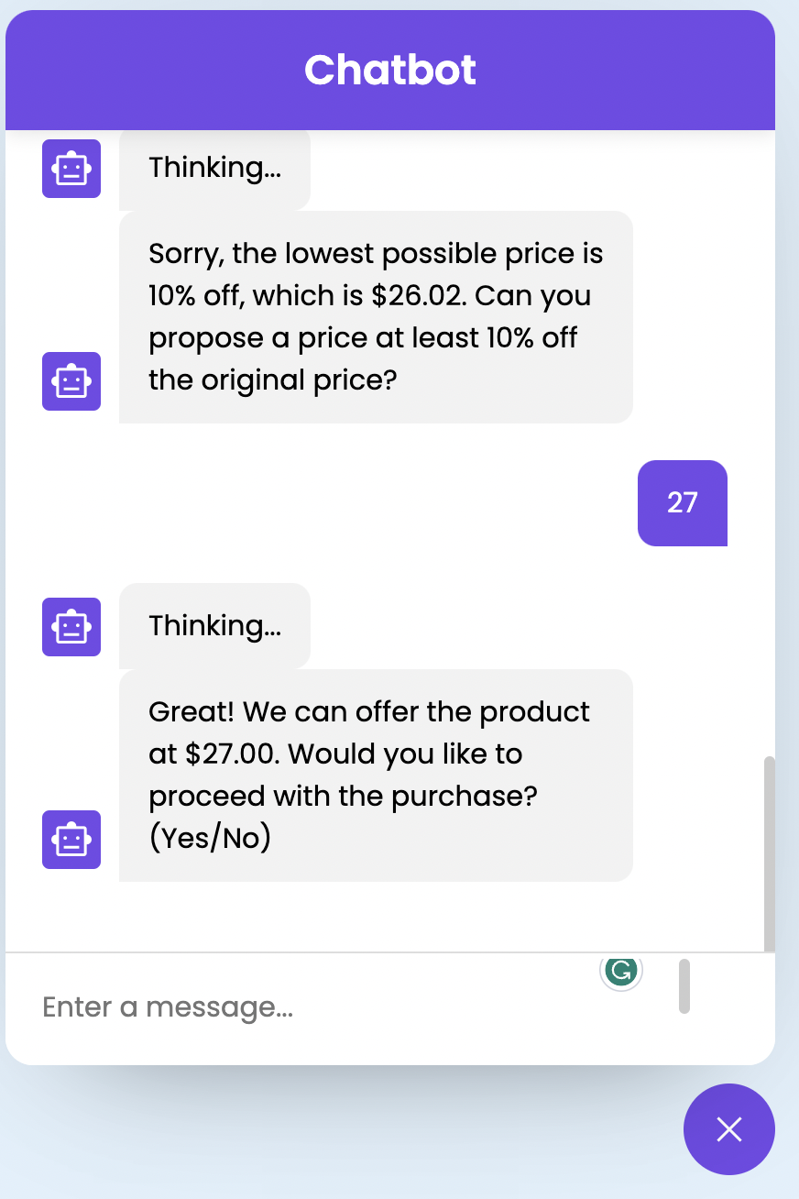
Output

Slide 10
Live Demo

Slide 11

Thank You

